Slide 1
GIT Github
Pregatit de: Alexandru Bottea Data: 20.06.2017

Slide 2
Topics - What is Git? - SSH - Basic Git - Github
Pregatit de: Alexandru Dima Data: 20.10.2014

Slide 3
Why git?
Ion

Slide 4
Why git?
Ion
Maria

Slide 5
Why git?
Ion
Maria
Ionut
Ioana

Slide 6
Why git?
Ion
Maria
Ionut
Ioana
WTF!?!?
WTF!?!?

Slide 7
What is git?

Slide 8
What is git?
Distributed revision control system
Originally developed by Linus Torvalds for the development of the Linux Kernel in 2005
Focus on speed and efficiency
Quite a unique design and therefore sometimes a bit scary and difficult to understand

Slide 9
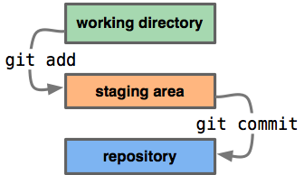
What is a repo?
A repository (repo) is simply a place where the history of your work is stored. It often lives in a .git subdirectory of your working copy.

Slide 10
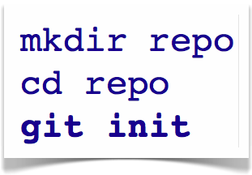

Basic git
Create a git repo
HEAD
master
C0

Slide 11
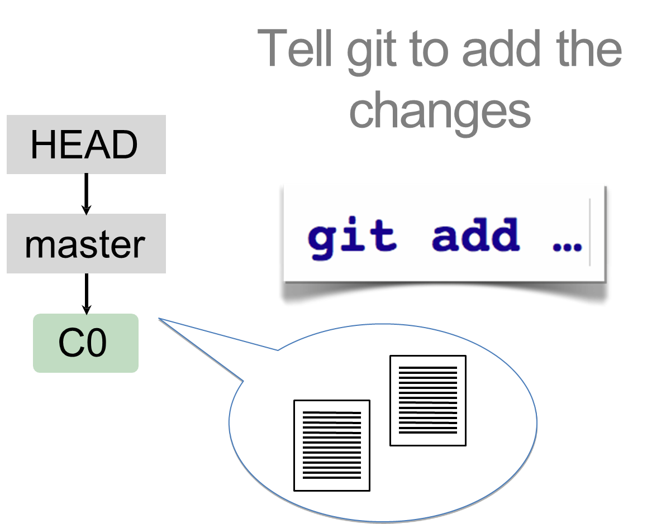
Basic git

Slide 12
Basic git
Using the SSH protocol, you can connect and authenticate to remote servers and services.
With SSH keys, you can connect to GitHub without supplying your username or password at each visit.

Slide 13
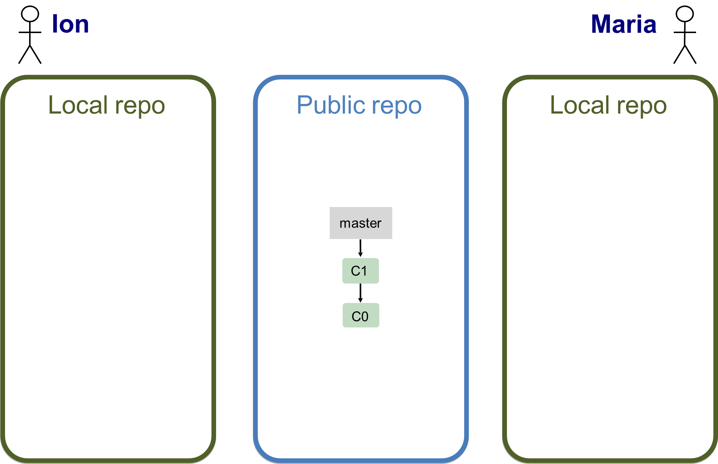
Collaborating

Slide 14
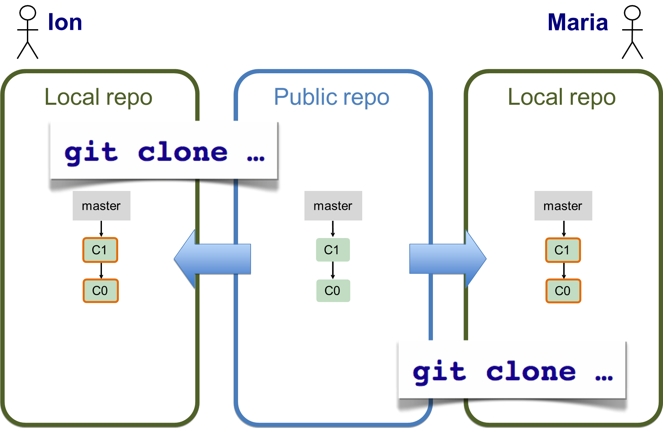
Collaborating

Slide 15
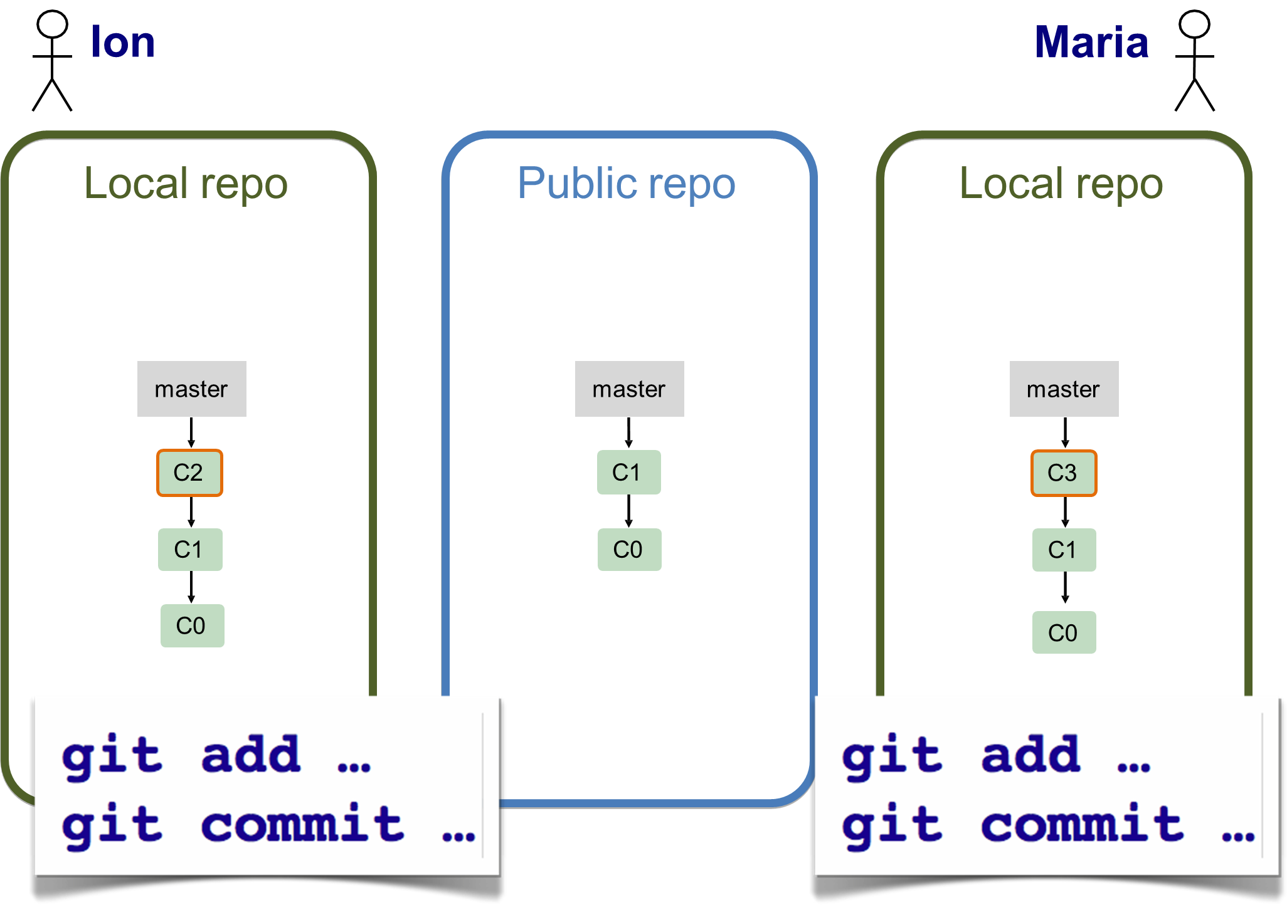
Collaborating

Slide 16
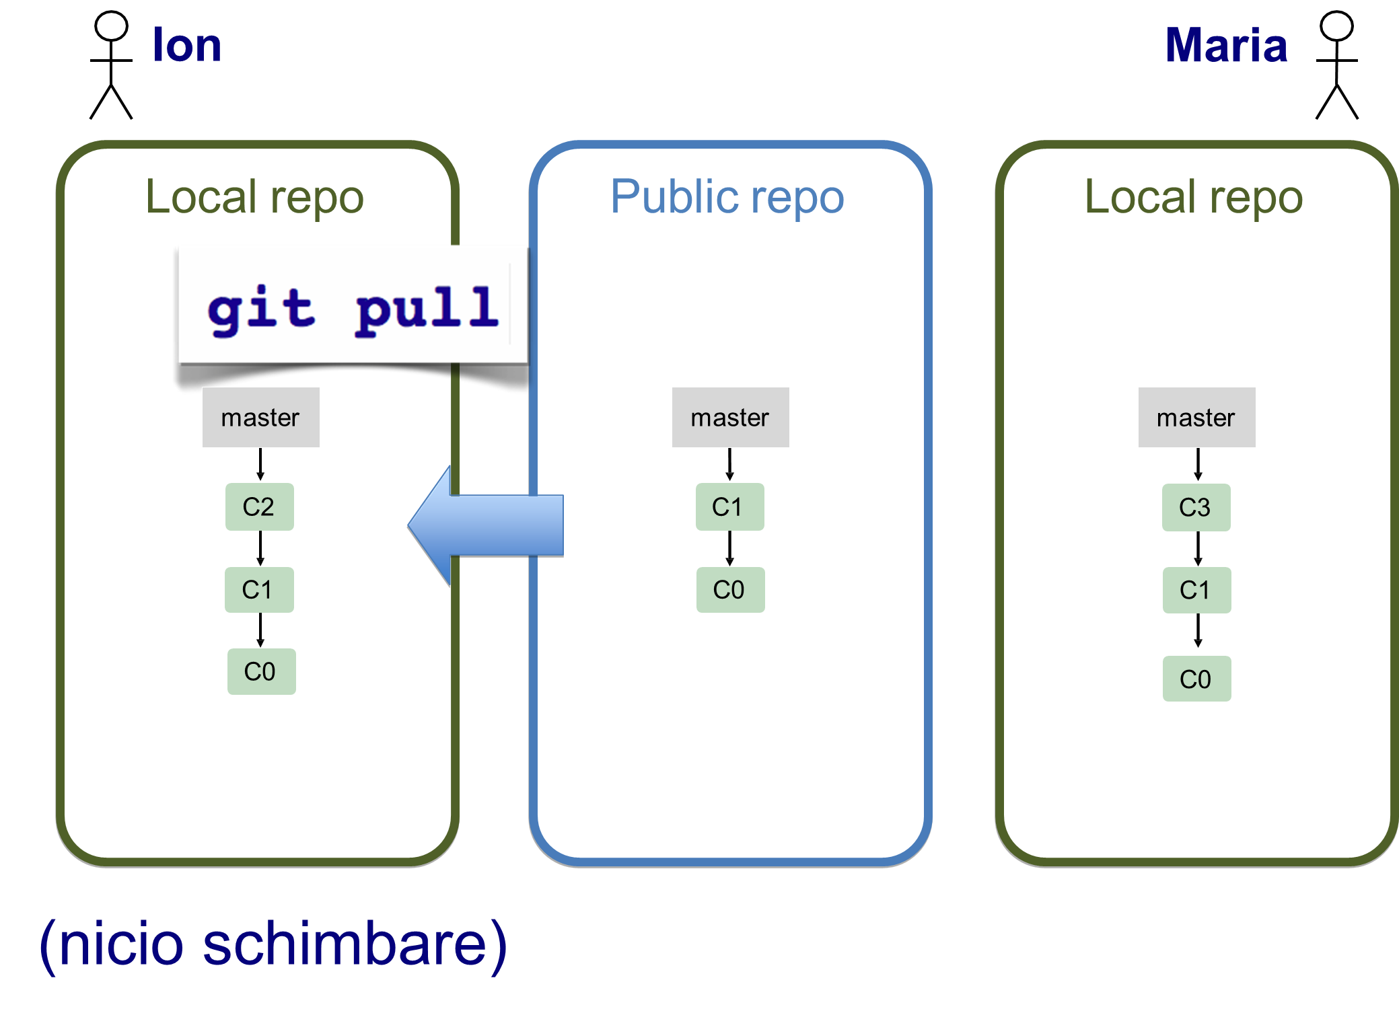
Collaborating

Slide 17
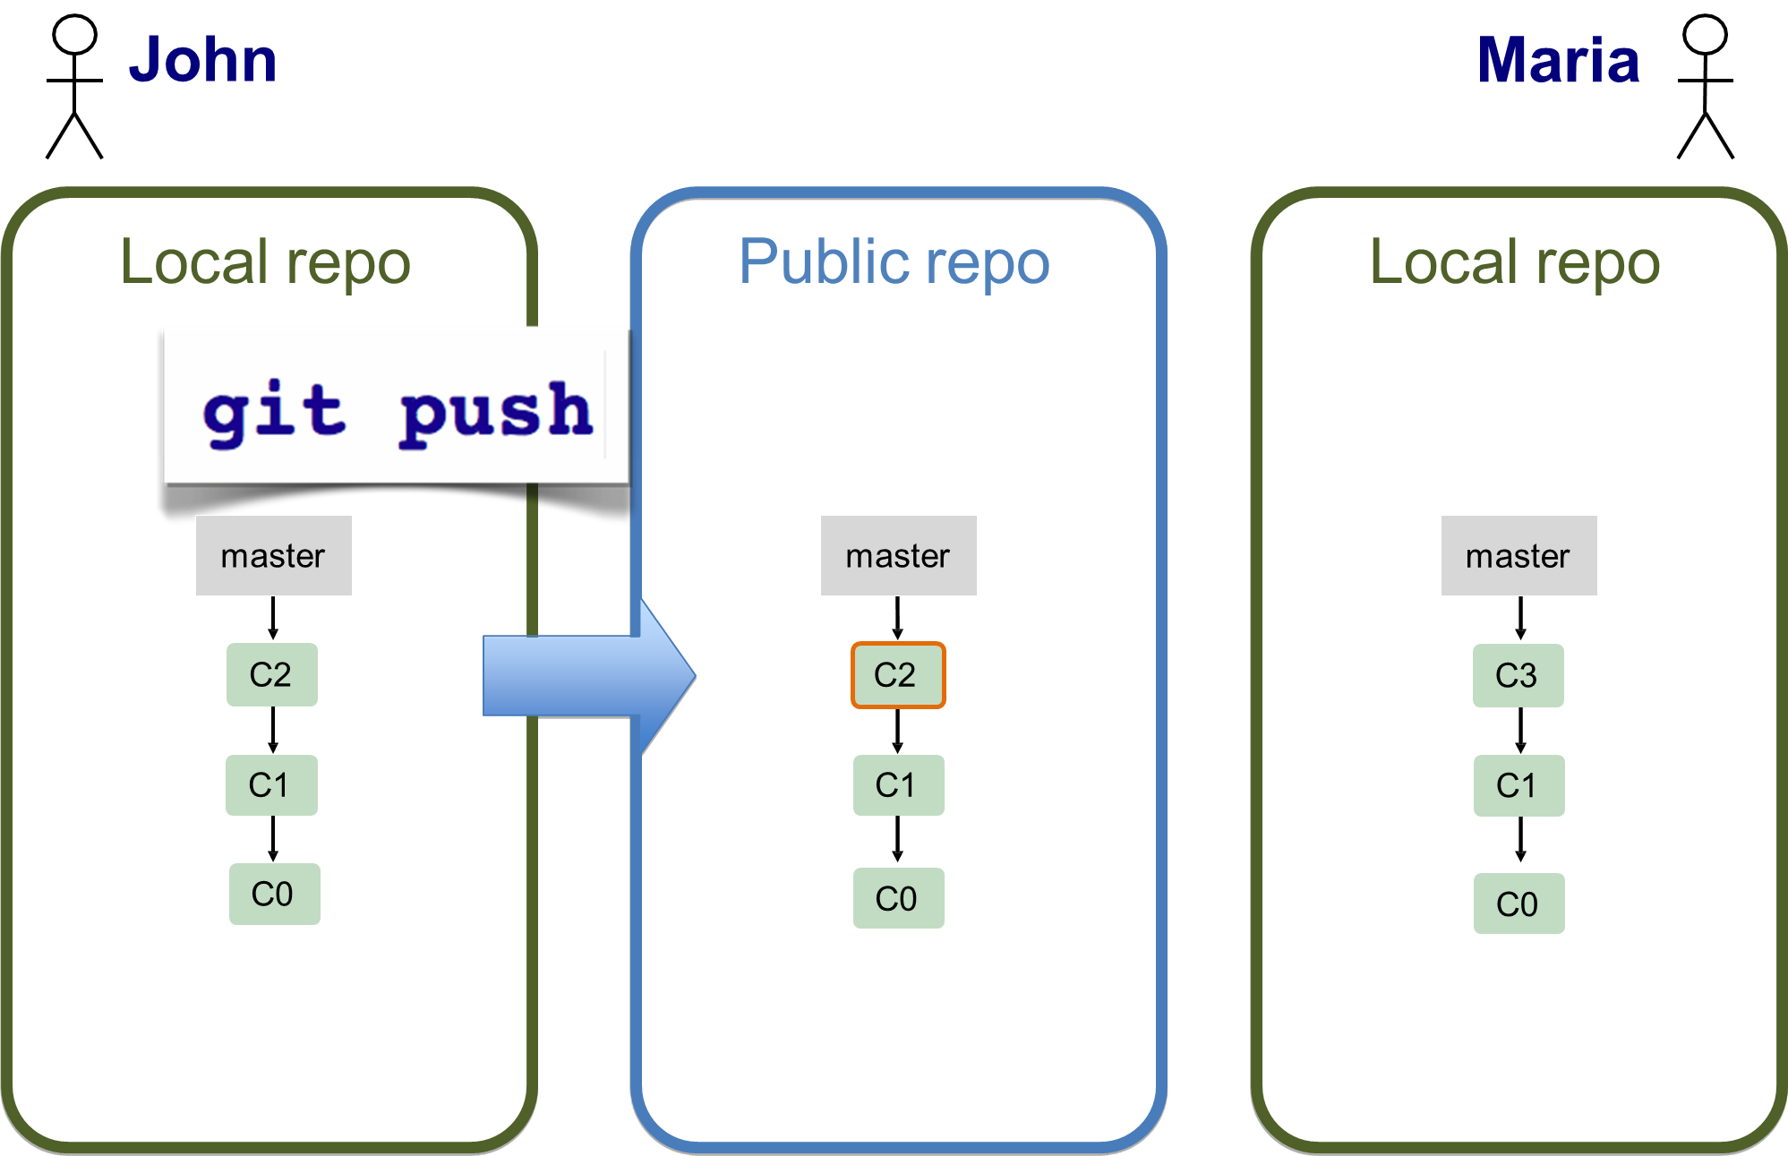
Collaborating

Slide 18
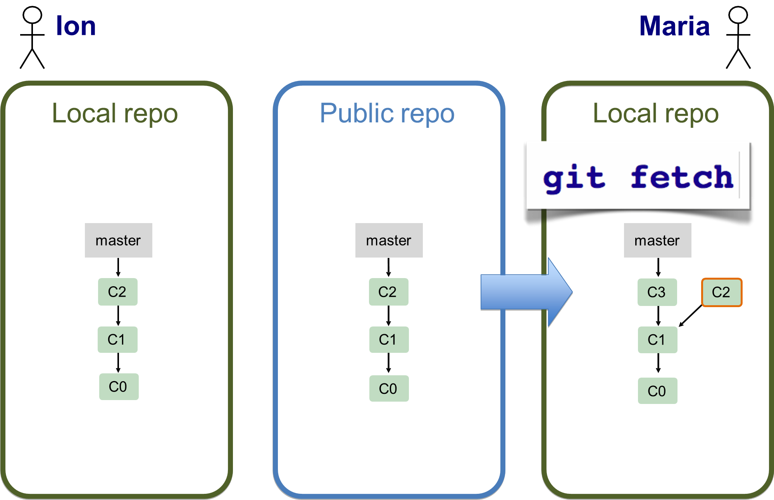
Collaborating

Slide 19
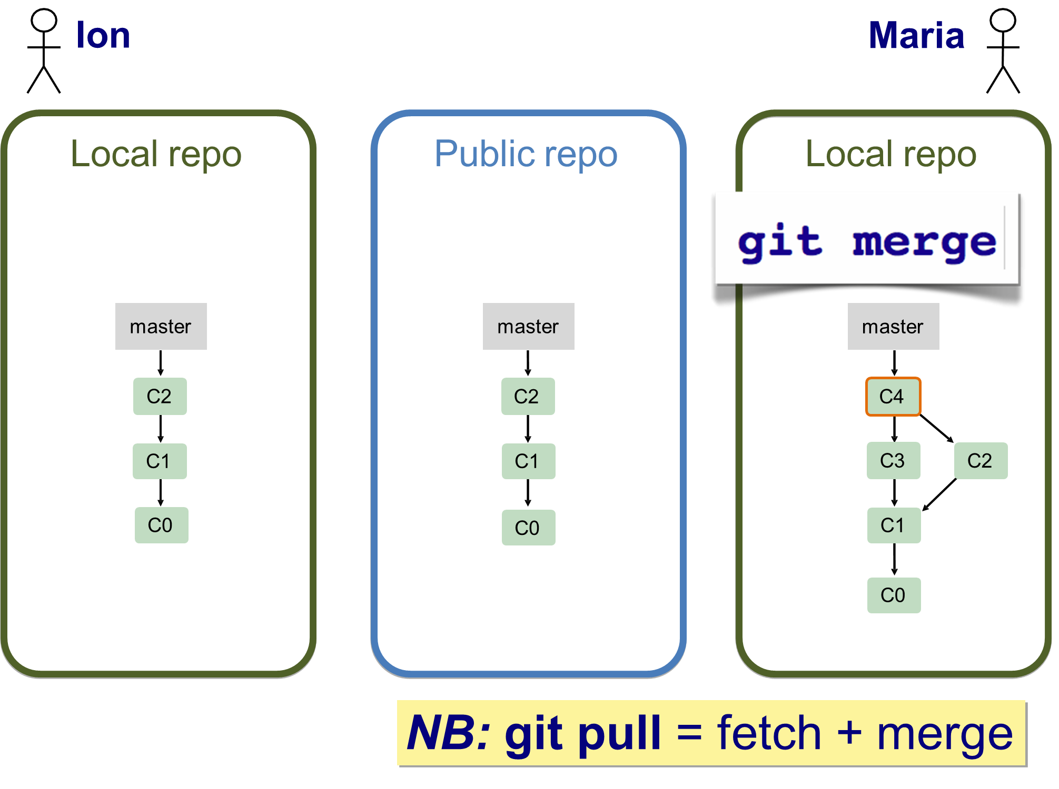
Collaborating

Slide 20
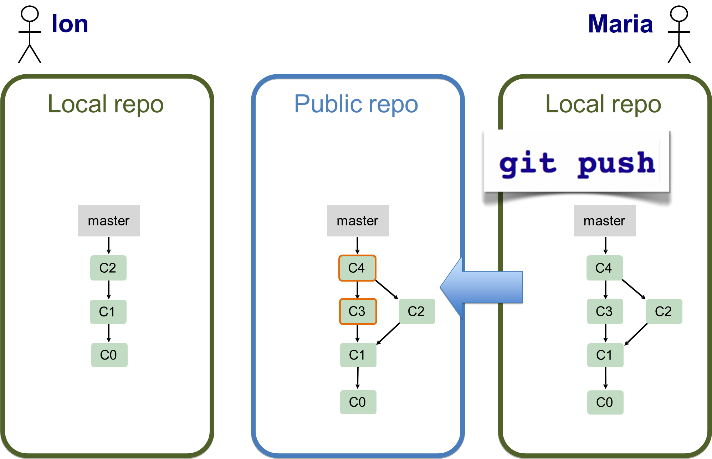
Collaborating

Slide 21
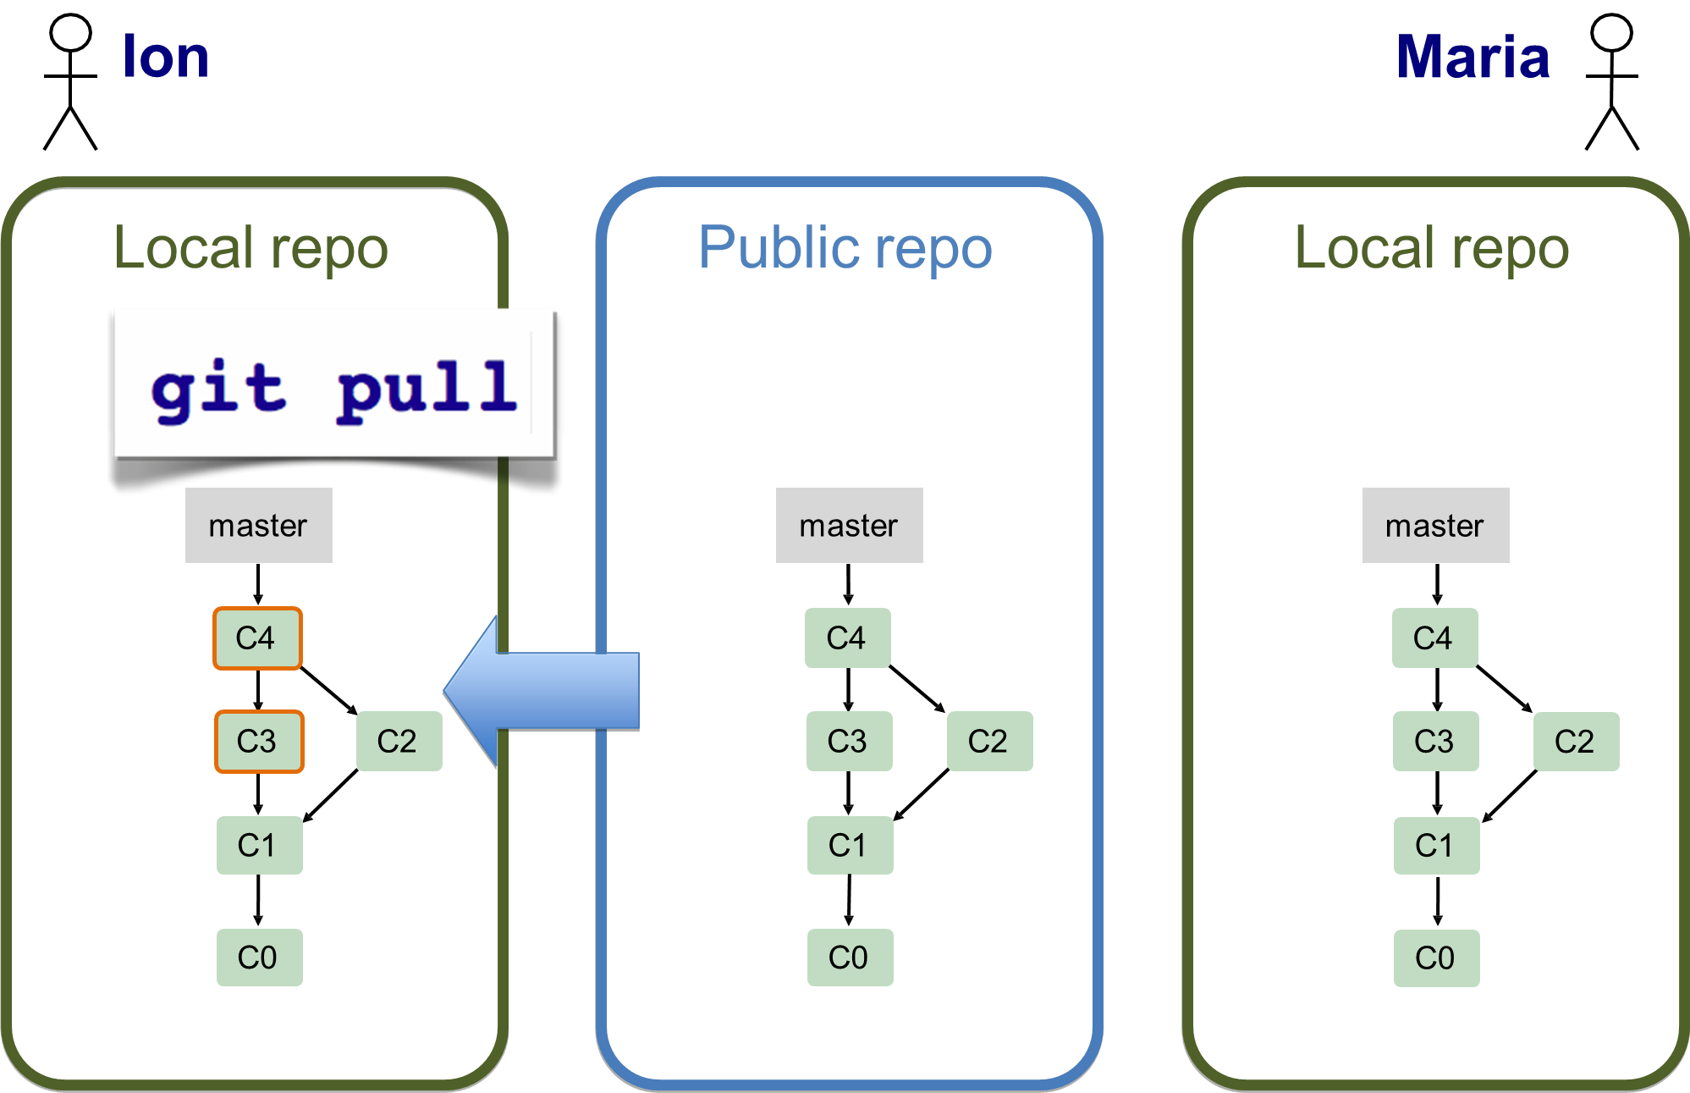
Collaborating

Slide 22
Collaborating
Here’s the git terminology:
master - the repository’s main branch. Depending on the work flow it is the one people work on or the one where the integration happens
clone - copies an existing git repository, normally from some remote location to your local environment.
commit - submitting files to the repository (the local one); in other VCS it is often referred to as “checkin”
fetch or pull - is like “update” or “get latest” in other VCS. The difference between fetch and pull is that pull combines both, fetching the latest code from a remote repo as well as performs the merging.
push - is used to submit the code to a remote repository
remote - these are “remote” locations of your repository, normally on some central server.
SHA - every commit or node in the Git tree is identified by a unique SHA key. You can use them in various commands in order to manipulate a specific node.
head - is a reference to the node to which our working space of the repository currently points.
branch - is just like in other VCS with the difference that a branch in Git is actually nothing more special than a particular label on a given node. It is not a physical copy of the files as in other popular VCS.

Slide 23
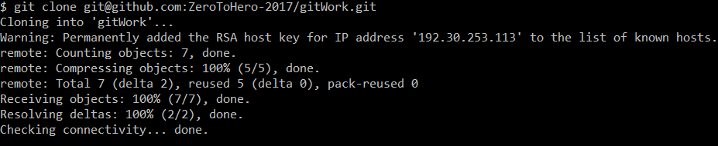
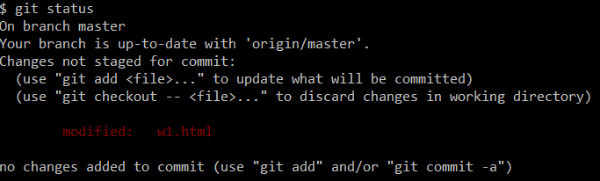
Collaborating
Commands:
- Cloning an existing remote repository: git clone
- Checking for changes: git status

Slide 24

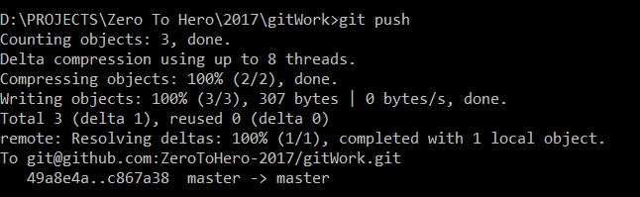
Collaborating
- Saving changes to local repository: git commit
- Pushing local changes to remote: git push

Slide 25
Collaborating
- Saving changes to local repository: git commit
- Pushing local changes to remote: git push

Slide 26
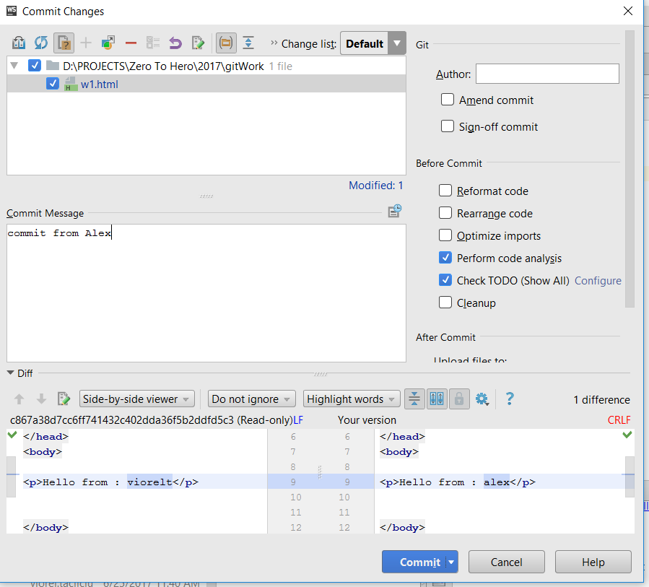
Collaborating
- Dealing with conflicts

Slide 27
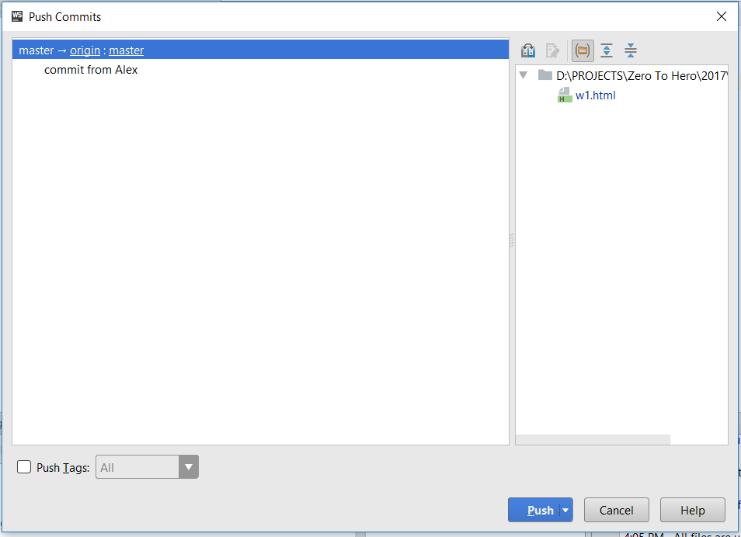
Collaborating
- Dealing with conflicts

Slide 28
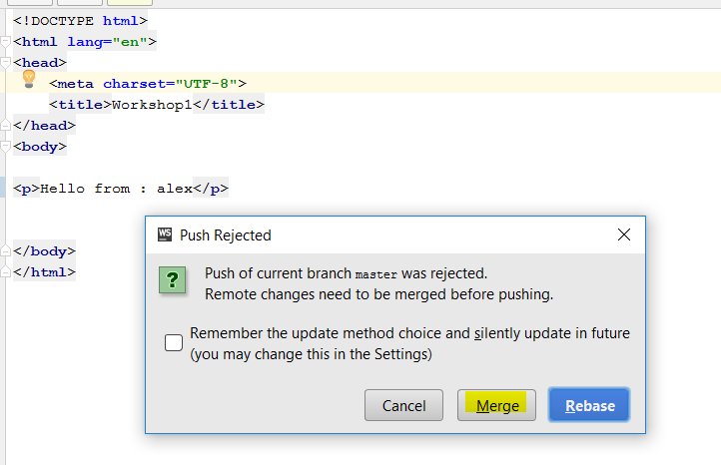
Collaborating
- Dealing with conflicts

Slide 29
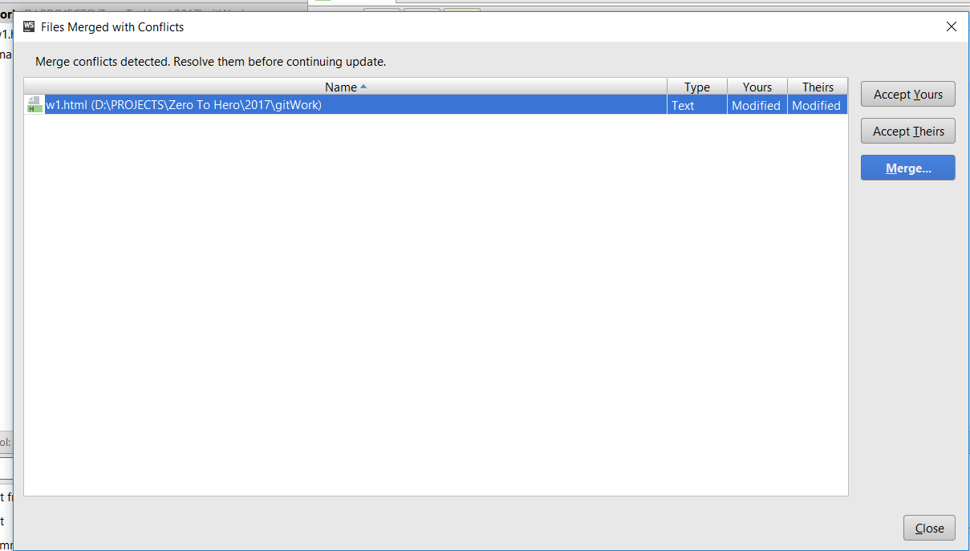
Collaborating
- Dealing with conflicts

Slide 30
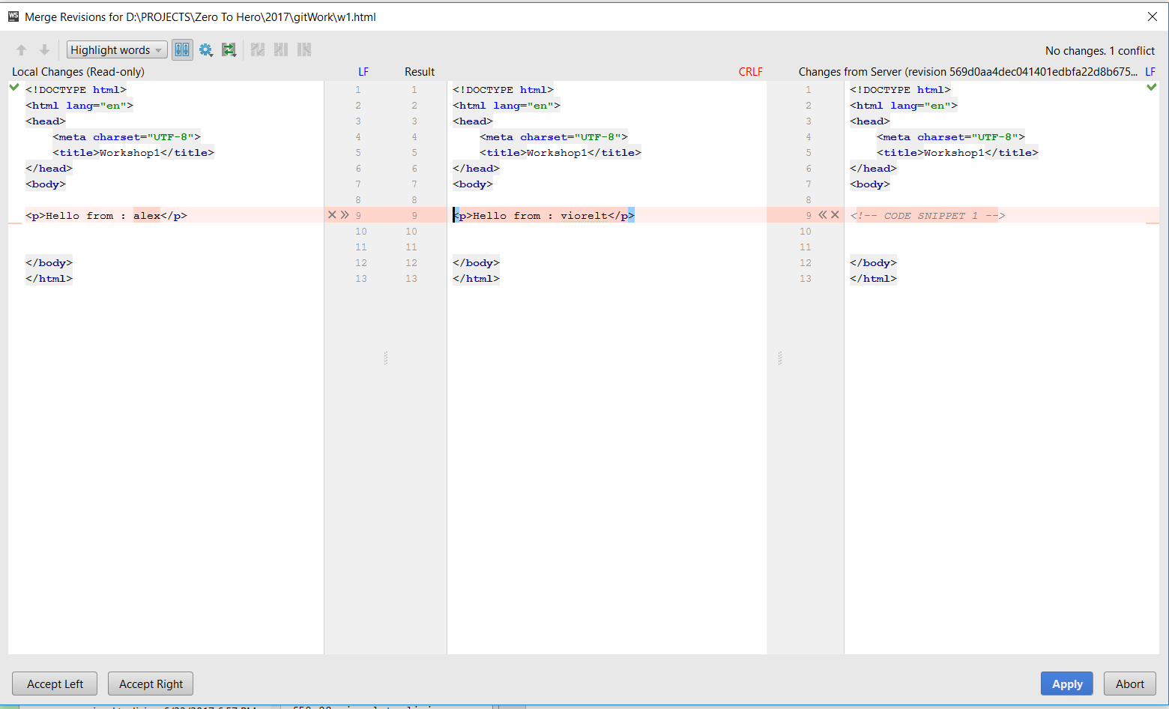
Collaborating
- Dealing with conflicts

Slide 31
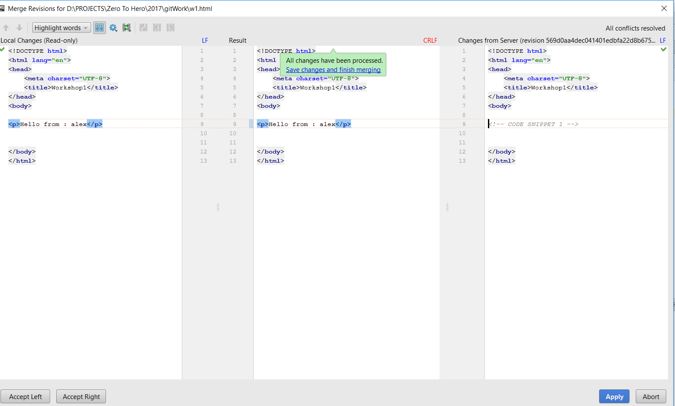
Collaborating
- Dealing with conflicts

Slide 32
Workshop: - Configure git - Generate ssh keys - WebStorm

Slide 33
Collaborating – github fork
Fork A Repo
A fork is a copy of a repository. Forking a repository allows you to freely experiment with changes without affecting the original project.
Most commonly, forks are used to either propose changes to someone else's project or to use someone else's project as a starting point for your own idea.
Fork an example repository
Forking a repository is a simple two-step process. We've created a repository for you to practice with!
On GitHub, navigate to the ZeroToHero-2017/gitWork repository.
In the top-right corner of the page, click Fork.
That's it! Now, you have a fork of the original ZeroToHero-2017/gitWork repository.

Slide 34
Workshop: - Resolve text conflict using merge - Collaboration using fork

Slide 35
Questions?

Slide 36
Thank you!

